Slide 1
Grad 778 – Week 11 Cloud Computing
Engin Arslan
Department of Computer Science and Engineering
Course slides are originally developed by Cristian Borcea of NJIT

Slide 2
Course outline
Overview of Cloud Computing and its types
Infrastructure as a Service (IaaS)
Platform as a Service (PaaS)
Function as a Service (FaaS) and serverless computing
Coding project in AWS
Create and configure an instance
Develop image detection code using AWS Rekognition

Slide 3
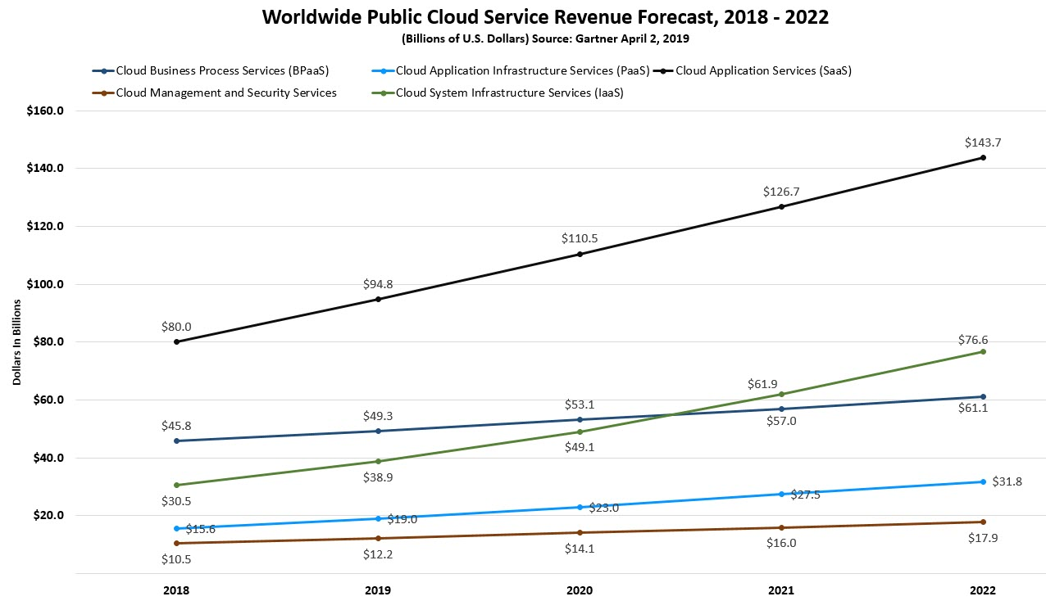
Cloud is big business

Slide 4
What is cloud computing?
Cloud = the name comes from the figures commonly used to represent the Internet as a cloud or as a series of connected clouds
Idea: computing doesn’t have to happen on my desktop or in my building – it can be anywhere
Technical view (What?)
Use of computing resources available as a service (Functions, Software, Platforms, or Infrastructure)
Resources can be accessed across the Internet
Business view (Why?)
Reduced costs through sharing and centralization
Flexibility and adaptability by rapid provisioning

Slide 5
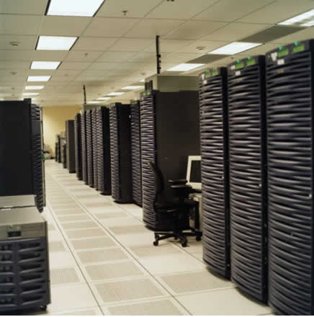
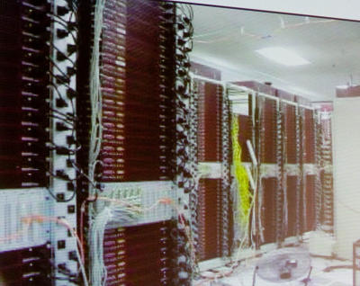
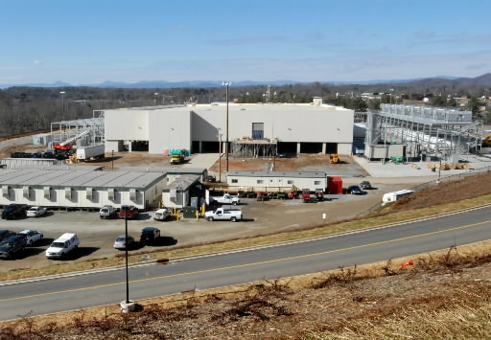
How it all started
Very large data centers with low utilization on average
How about renting computers when load is low?
Google data center video: https://www.youtube.com/watch?v=XZmGGAbHqa0

Slide 6




Traditional data center: heavy penalty for under-provisioning
Resources
Capacity
Demand
Resources
Capacity
1
2
3
Time (days)
Demand
Lost revenue
1
2
3
Time (days)
Resources
Capacity
Demand
1
2
3
Time (days)
Lost users

Slide 7
Economics of cloud model
Capacity
Resources
Resources
Demand
Capacity
Demand
Time
Time
Static data center
Data center in the cloud
Unused resources

Slide 8
Cloud entities
Cloud providers: offer hardware & management tools
Many times provide system services (e.g., local OS + persistent storage + system software like compilers)
Can provide other (user-level) services
Cloud customers
Service providers: use the cloud to provide user-level services (accessible across the Internet)
End users: use the services offered by service providers

Slide 9
Provider’s benefits
Renting an IT infrastructure to many users
Sharing of resources
Reduction of costs through scale
Centralized monitoring and maintenance
Control over software evolution
Control over service level agreements

Slide 10
Consumer’s benefits
Reduced capital expenditure for hardware, software, services
Reduced operational expenses: pay as you go (dynamic provisioning)
Simple to achieve scalability and flexibility
More predictable costs
Note: there are scenarios where cloud can be more expensive than owning an infrastructure

Slide 11
Cloud attributes
Multi‐tenancy: many apps co‐existing on the same infrastructure
Fast provisioning: near real-time deployment
Elasticity: fast and graceful response to changing resource requirements
Scalability: scaling to growing data and apps
Load and tenant balancing: absorbing load spikes, not to overload the hardware
Availability: cloud must be always on
Security: no security breach
Metering: monitoring usage for resource provisioning and pricing
Fine-grained price model: usage-based
Simple management by customers: browser dashboard
Simple APIs: generally, web service APIs

Slide 12
Types of services
Infrastructure-as-a-Service (IaaS)
Virtual servers with unique IP addresses and blocks of storage on demand (e.g., Amazon EC2)
Platform-as-a-Service (PaaS)
Set of software and development tools (API) hosted on the provider's servers (e.g., Azure Cloud Services)
Software-as-a-Service (SaaS)
The provider allows the customer only to use its applications (e.g., web-based email, web stores, etc)
Function-as-a-Service (FaaS)
The provider allows the customer to trigger functions, while taking care of VMs, scalability, fault-tolerance, etc.

Slide 13
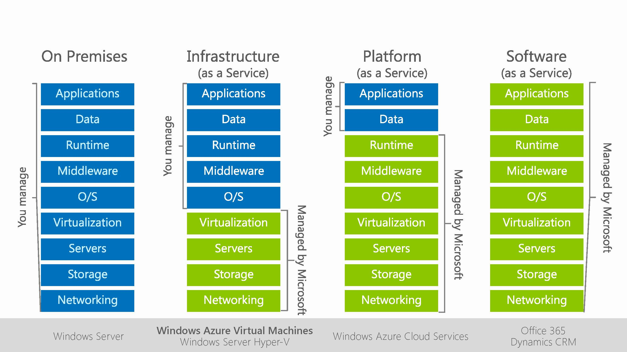
Who manages what in IaaS, PaaS, and SaaS

Slide 14
IaaS characteristics
Allow customers to build, configure, and optimize virtual infrastructure in the cloud
Virtual infrastructure consists of:
Virtual Machines (VMs)
Running OSs provided by the cloud provider or customer
Wide range of vCPU and memory configurations
Virtual Storage
Multiple types: block storage (i.e., virtual disk), archival storage, cloud databases, etc.
Virtual Networks
Including networking and security tools: DNS servers, Load balancers, Firewalls, IDS, etc.
Tools for resource management and system monitoring
Dashboard to create resources, monitor utilization and pricing, etc.

Slide 15
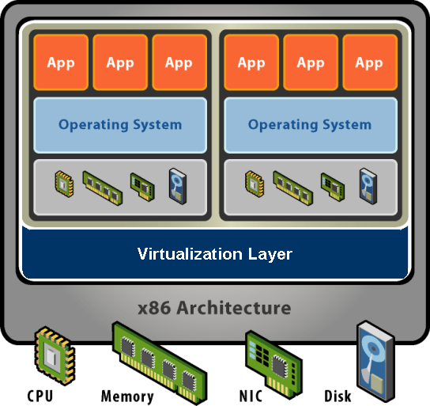
What exactly is a Virtual Machine (VM)?
Software abstraction
Behaves like hardware
Encapsulates all OS and application state
Multiplexes physical hardware across VMs

Slide 16
AWS IaaS: Elastic Compute Cloud (EC2)
On-demand VMs (instances), launched by customers
Select instance type (i.e., virtual hardware configuration)
Select OS – Amazon Machine Image (AMI)
Each instance has its own vCPU, memory, network interface, and disk space (volatile – data is lost when the instance is terminated)
EC2 management console provides instance management and configuration services
Launch and terminate instances
Control instance properties
Set network access permissions for instances

Slide 17
AWS storage
Simple Storage Service (S3): provide persistent storage
Independent of EC2 instances; can be accessed from the Internet
EC2 instances need to “download” data from S3 in order to access it (cannot issue read/write to S3)
Amazon S3 Glacier: low-cost storage service that provides secure and durable storage for data archiving and backup
Advantage over S3: offload the administrative burdens of operating and scaling storage + cost
Disadvantage: slower than S3
Storage Gateway: hybrid cloud storage service that gives you on-premises access to virtually unlimited cloud storage
Tape Gateway, File Gateway, and Volume Gateway seamlessly connect on-premises applications to cloud storage, caching data locally for low-latency access

Slide 18
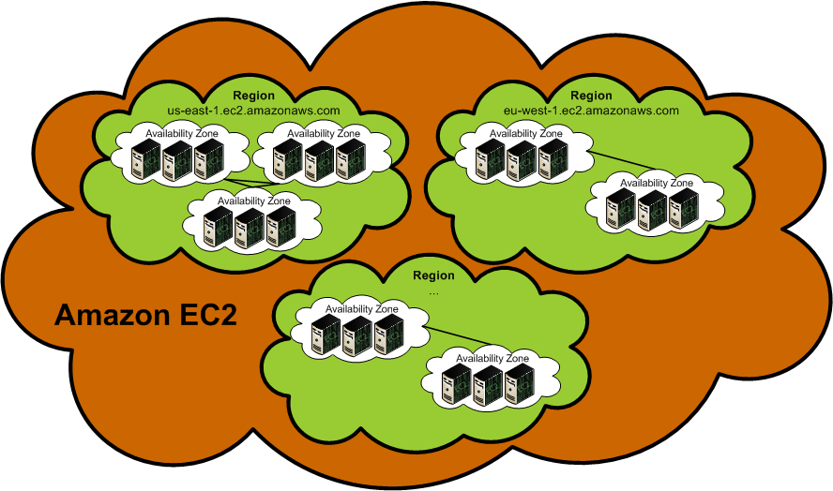
Regions and availability zones
EC2 instances are launched in regions
Regions located in separate geographic areas (US: Virginia, Ohio, Oregon, California; Ireland, Singapore, etc.)
Each region is completely isolated
Failure independence and stability
Availability Zones are distinct locations within a Region
Isolated, but connected through low-latency links
Failure resilience
Current pricing: http://aws.amazon.com/ec2/pricing/

Slide 19
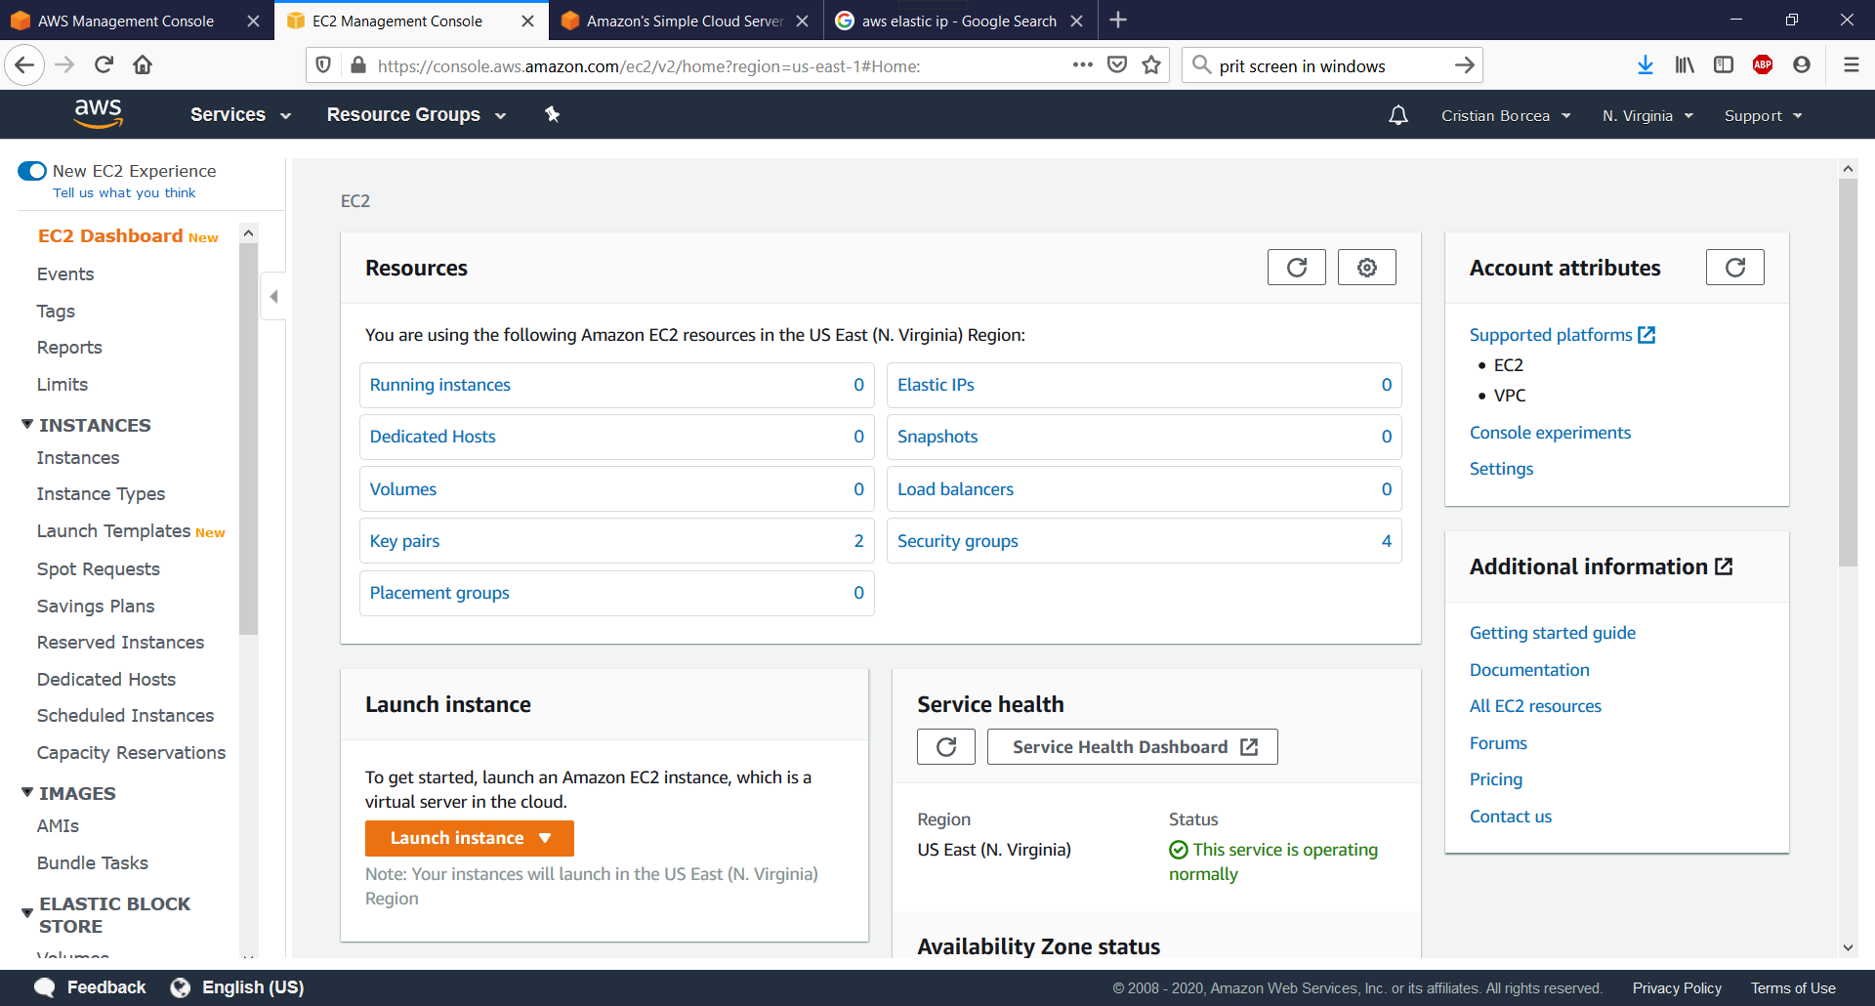
Login AWS management console

Slide 20
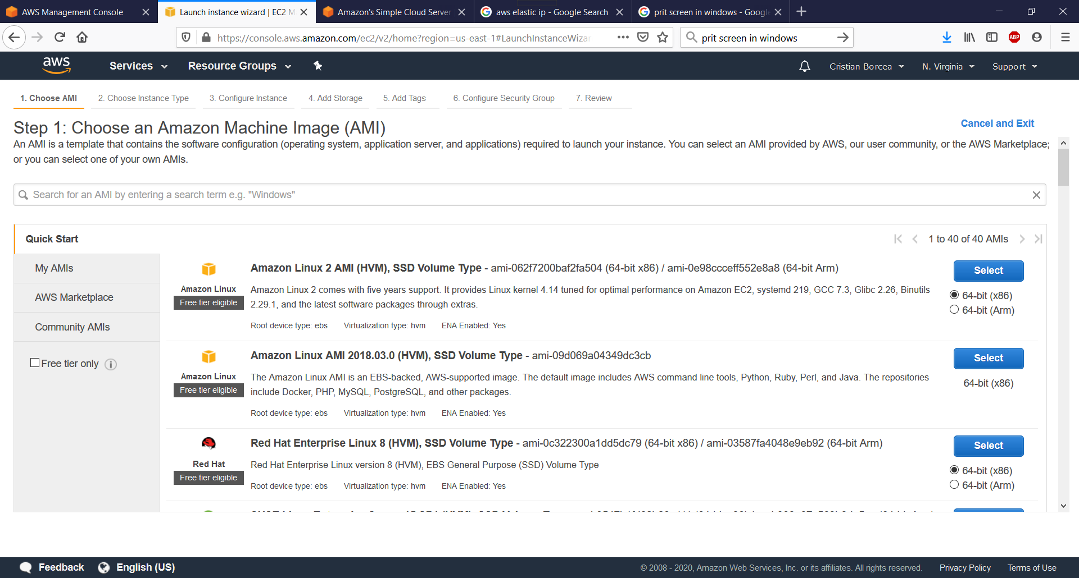
Select AMI to create instance(s)
Select instance type: http://aws.amazon.com/ec2/instance-types/

Slide 21
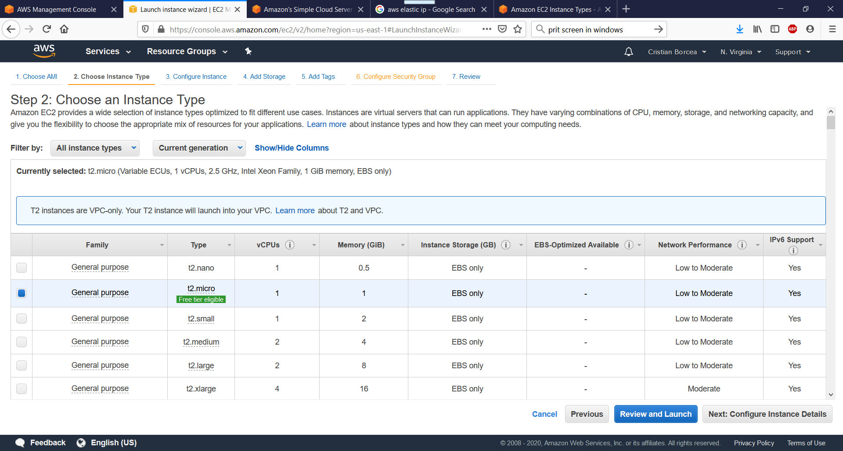
Select instance type

Slide 22
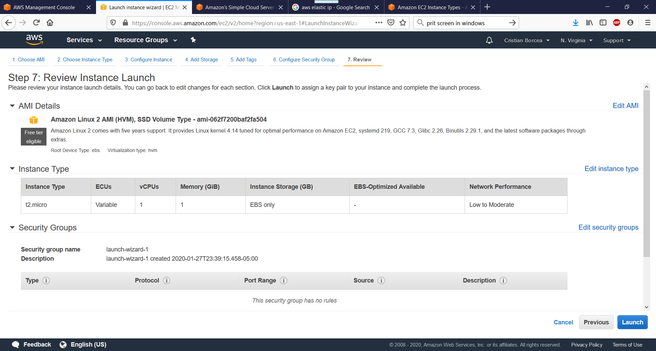
Review and launch

Slide 23
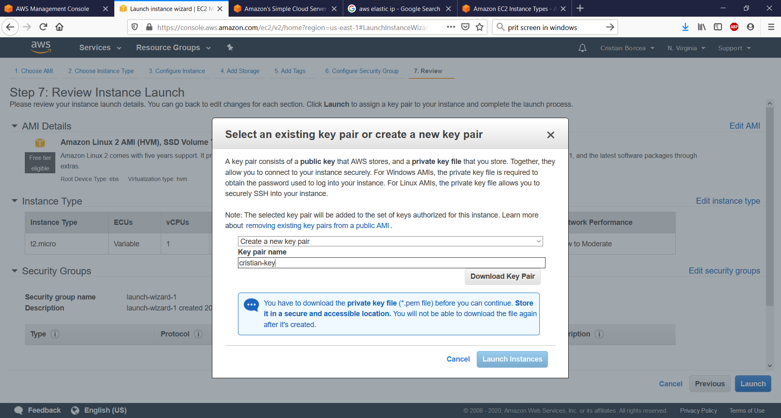
Create and download key pair

Slide 24
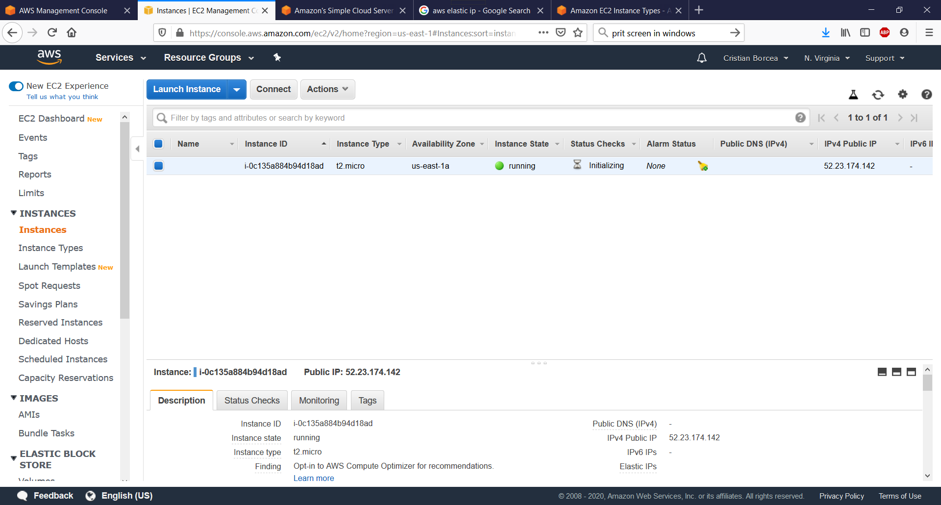
Instance is running

Slide 25
Connecting to instances
Linux Instance
Connect from your browser using the Java SSH Client
Putty.exe/putty key generator
SSH command on Linux machine
ssh -i my-aws-key.pem ec2-user@52.23.174.142
Windows instance
Connect from your browser using the Java SSH Client
Connect using Remote Desktop

Slide 26
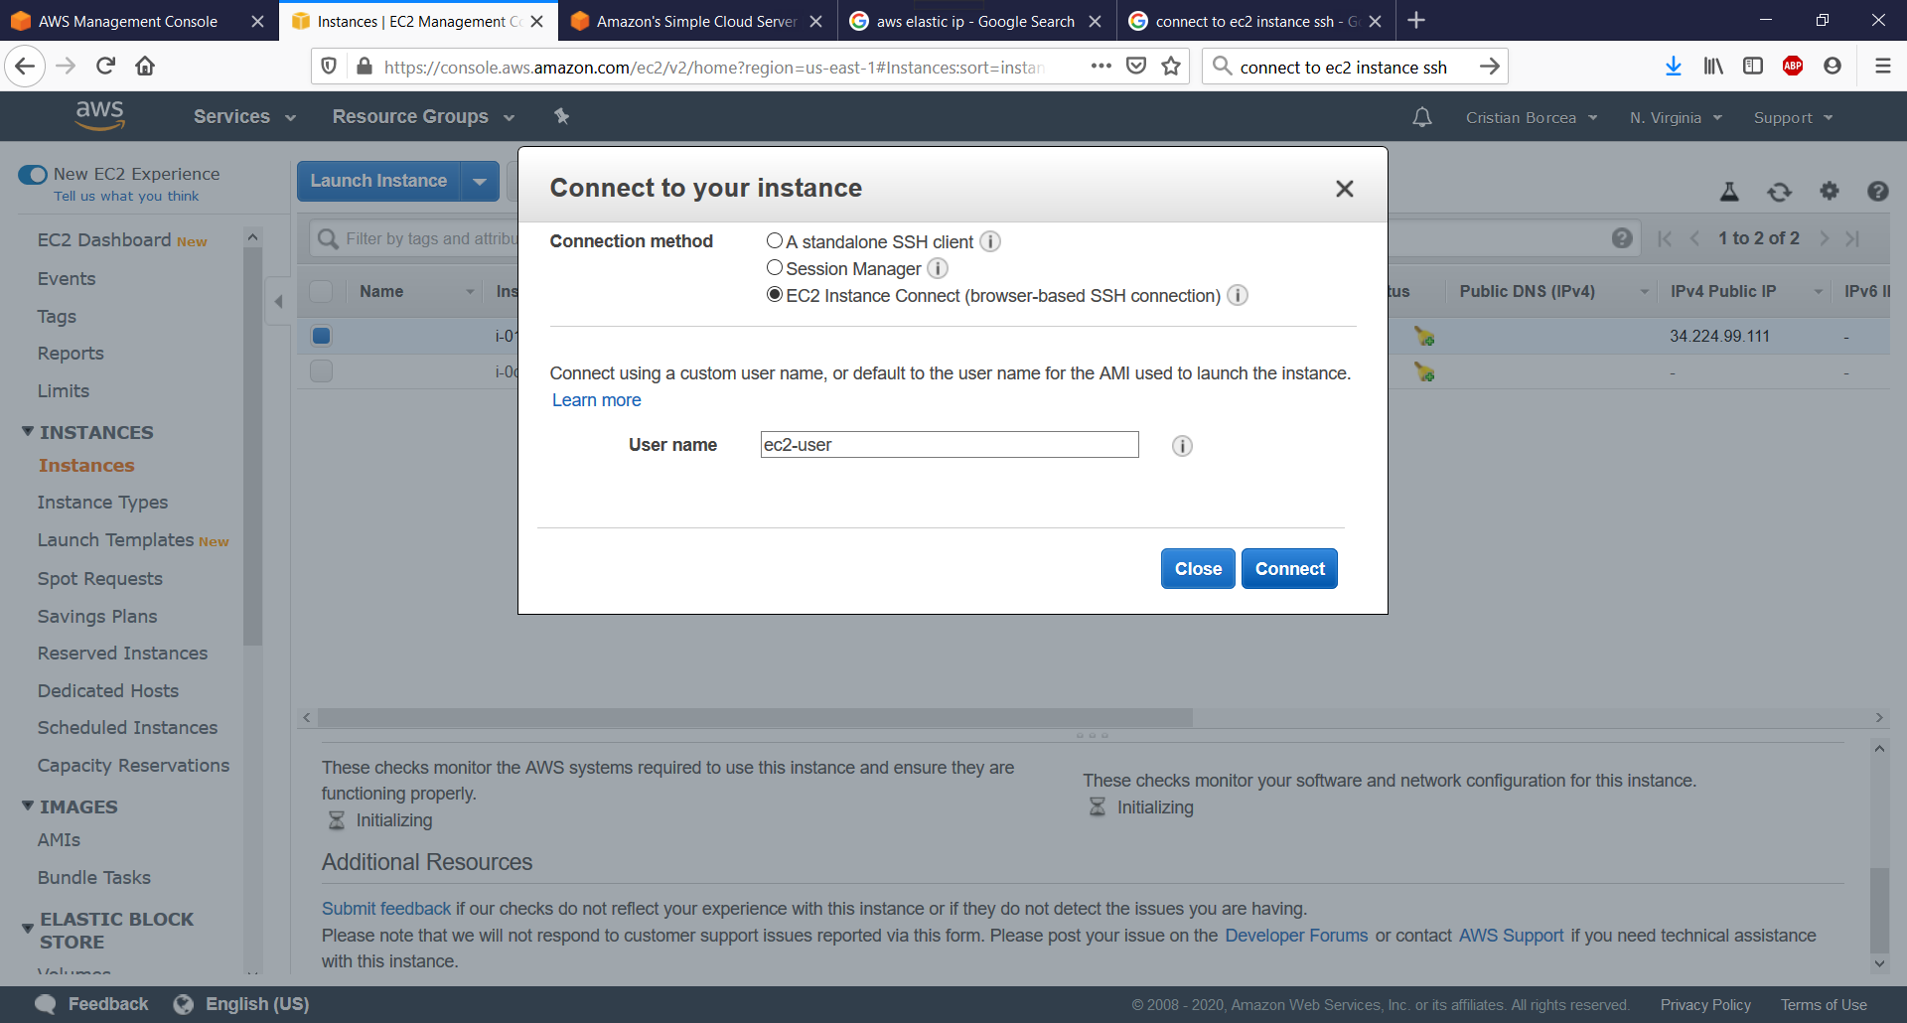
Connect to Linux instance (1)

Slide 27
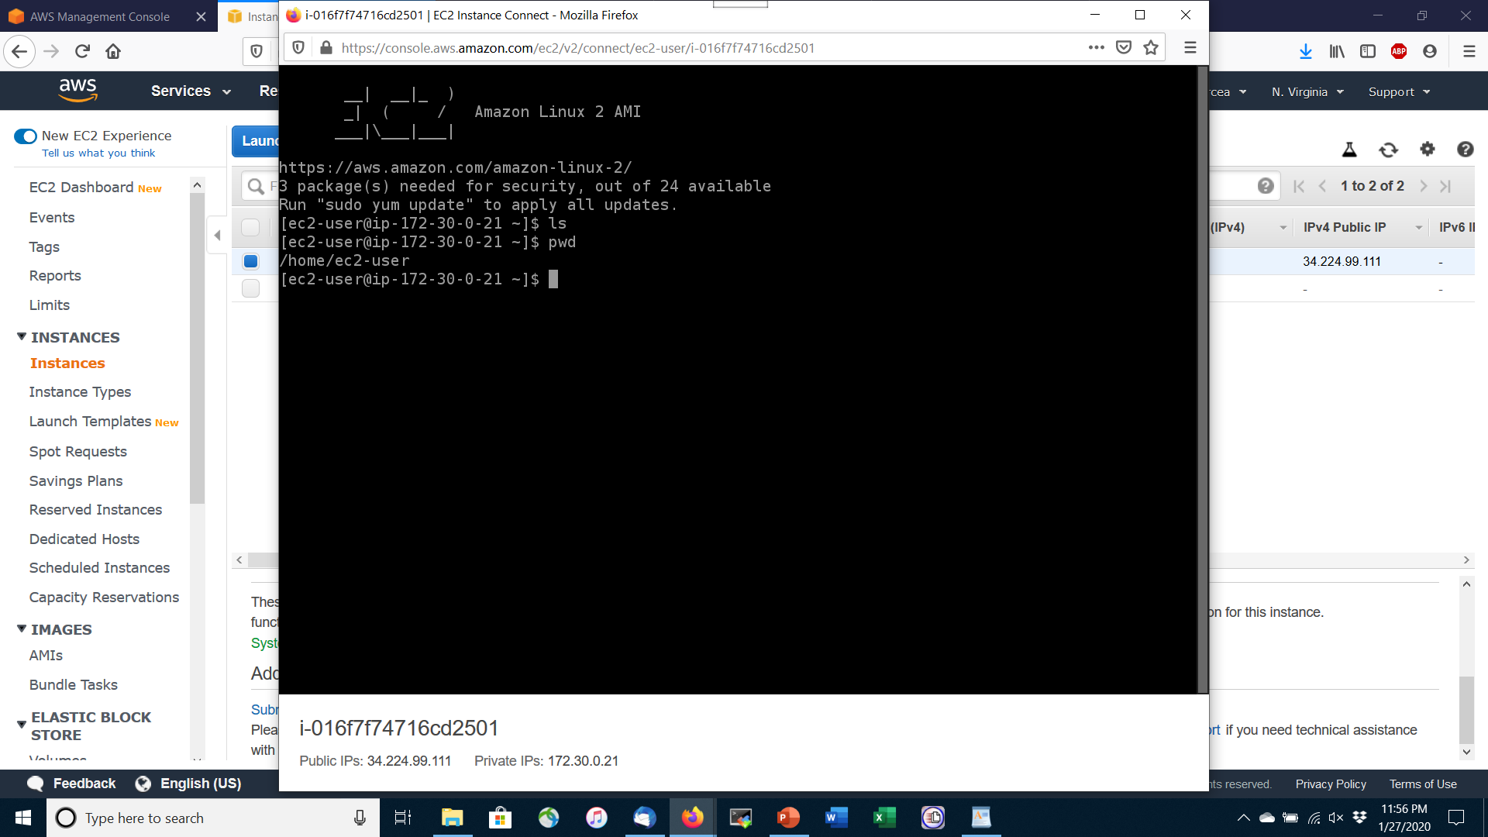
Connect to Linux instance (2)

Slide 28
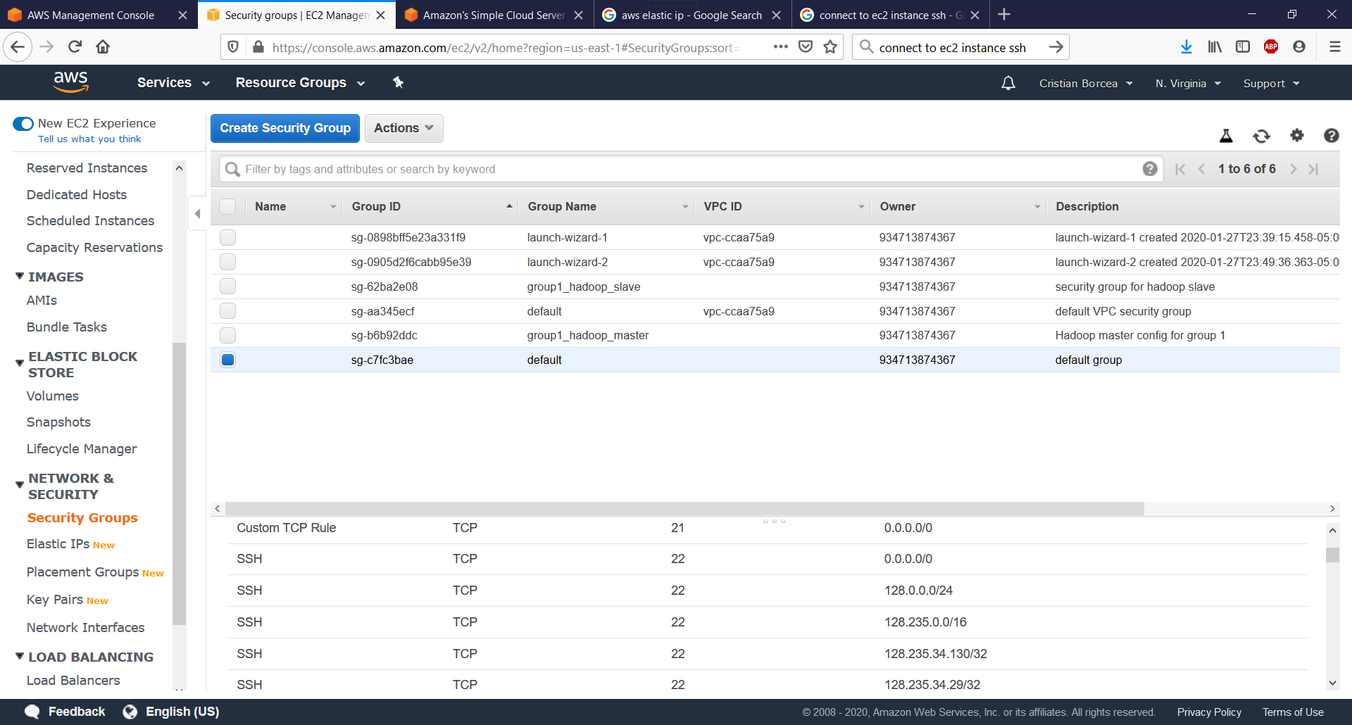
Illustration of security group

Slide 29
AWS Object Detection Example
Access the documentation here
https://docs.google.com/document/d/1A24qBj1cWi86zPou2FtffpQa0Vnmx31du9KuQjP7WC4/edit?usp=sharing

